Slide 1
VE203 Midterm 1 Review
Zhu Chenyu

Slide 2
Outline
Propositions
Predicates
Set Theory
Relations
Partial Orders
Lattices

Slide 3
Propositional Logic
Definition of proposition:
A declaritive sentence that is either true or false.

Slide 4
Propositional Logic
For compound propositions:
Unary connective: ¬(not)
Four binary connectives ∨(disjunction), ∧(conjunction), ⇒(implication) and ⇔ (biconditional)
And their definitions

Slide 5
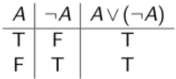
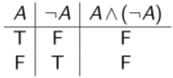
Propositional Logic
Truth table! (It is easy to understand and very useful)
A compound expression that is always true is called a tautology.
A compound expression that is always false is called a contradiction.

Slide 6
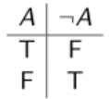
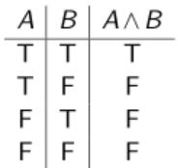
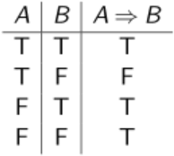
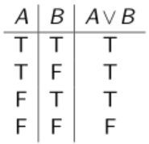
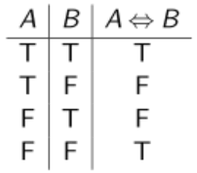
Basic Truth Tables

Slide 7
Propositional Logic
Equivalent
if A⇔B is a tautology, then A and B are logically equivalent. We can also write A≡B.

Slide 8

Some important tautologies
De-Morgan rules:
The contrapositive of A⇒B:
Commonly used in proof by contradiction

Slide 9
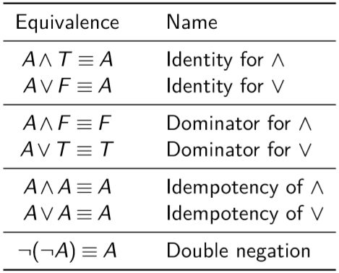
Logical Equivalences

Slide 10
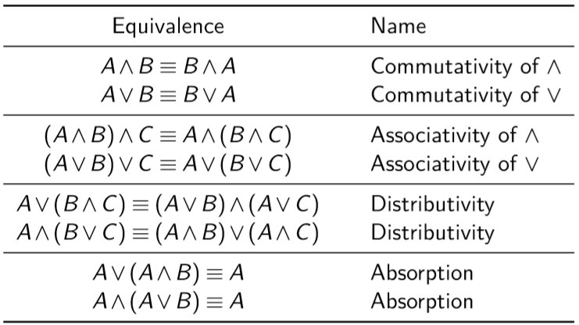
Logical Equivalences

Slide 11
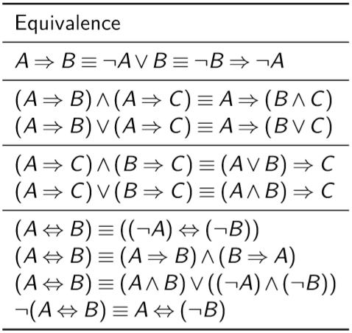
Logical Equivalences

Slide 12
Logical Equivalences
Note that the order of operation for the propositional connectives is: bracketed expressions, then ¬, then ∧ and ∨, then ⇒ and ⇐⇒. Brackets should always be used to distinguish between ∧ and ∨, and ⇒ and ⇐⇒.

Slide 13
Arguments
An argument is a ﬁnite sequence of propositions. All propositions except for the ﬁnal statement are called premises while the ﬁnal statement is called the conclusion. We say that an argument is valid if the truth of all premises implies the truth of the conclusion. We say that a valid argument is sound if all the premises are true.

Slide 14
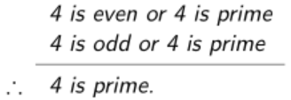
Arguments

Slide 15
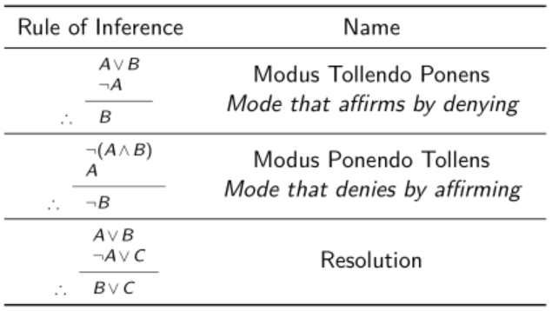
Some basic Arguments

Slide 16
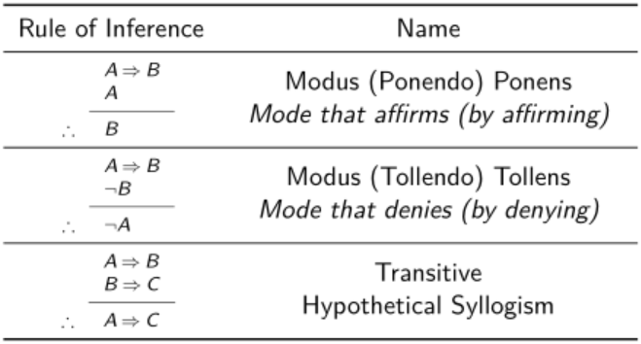
Some basic Arguments

Slide 17
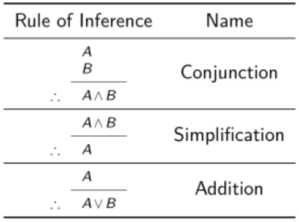
Some basic Arguments

Slide 18
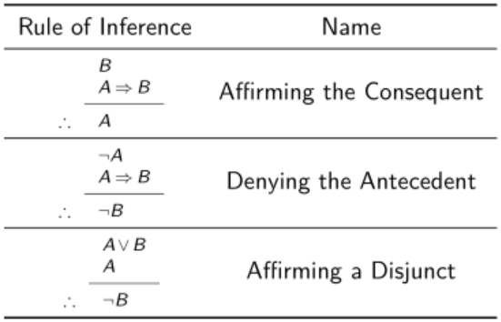
Commonly made Mistakes

Slide 19
Predicates
A predicate is a declaritive sentence involving variables. i.e. a statement involving variables such that when the variables a substituted with appropriate individuals we obtain a proposition.

Slide 20
Predicate Logic
Bounding variables in a compound expression using the logical quantiﬁer ∀, that reads “for all ...”, or the logical quantiﬁer ∃, that reads “there exists ...”
Pay attention to the order of quantifiers if they are different!

Slide 21
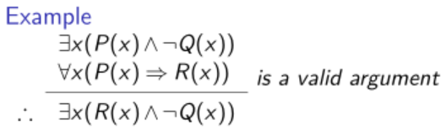
Predicate Logic

Slide 22
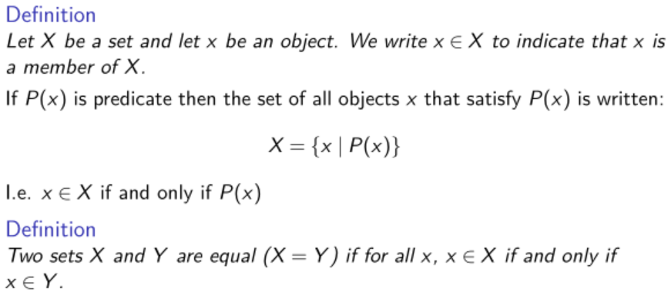
Naive Set Theory

Slide 23
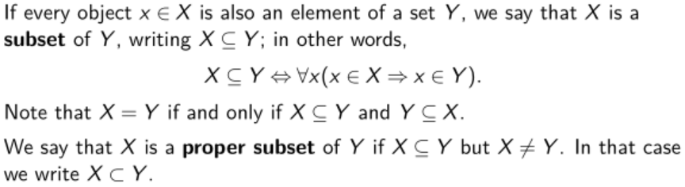
Subsets

Slide 24
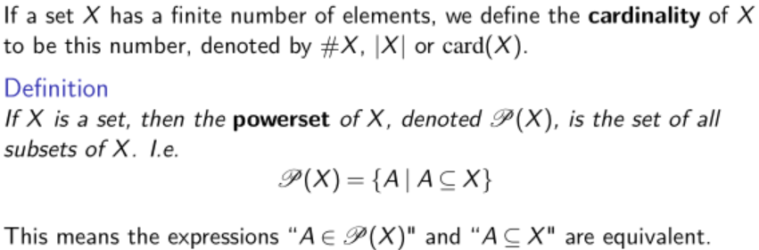
Powerset and Cardinality

Slide 25
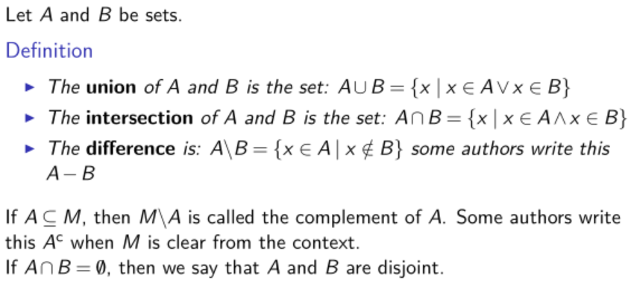
Operations on Sets

Slide 26
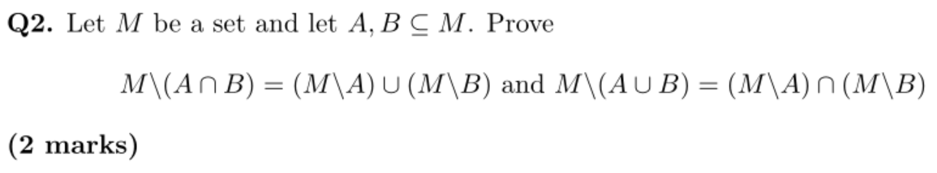
Assignment Question

Slide 27
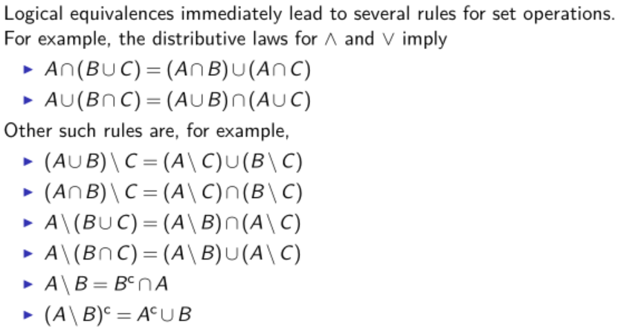
Operations on Sets

Slide 28
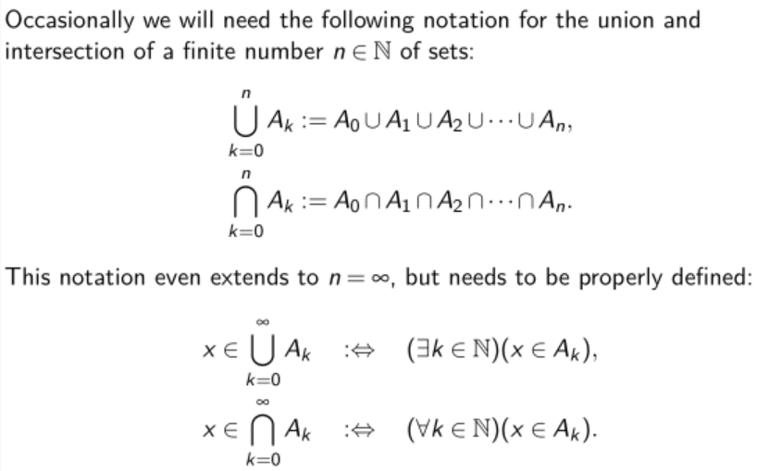
Operations on Sets

Slide 29
Venn's Diagrams
Sometimes drawing a Venn Diagram may help understanding the relationships.
Try to use De-Morgan Rules and identical transformation during exams.

Slide 30
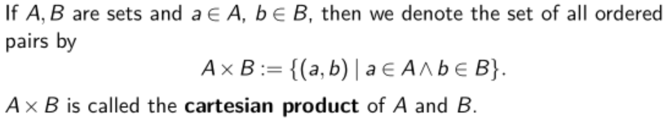
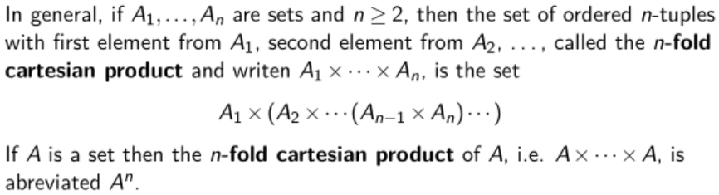
Cartesian Products of Sets

Slide 31
Summary-Propositions and Sets
Proposition
Predicate + appropriate substitution = Proposition
Logical Equivalences
Predicate Logics
Use of De-Morgan Rules!
Use of Truth Table!
Identical Transformation!

Slide 32
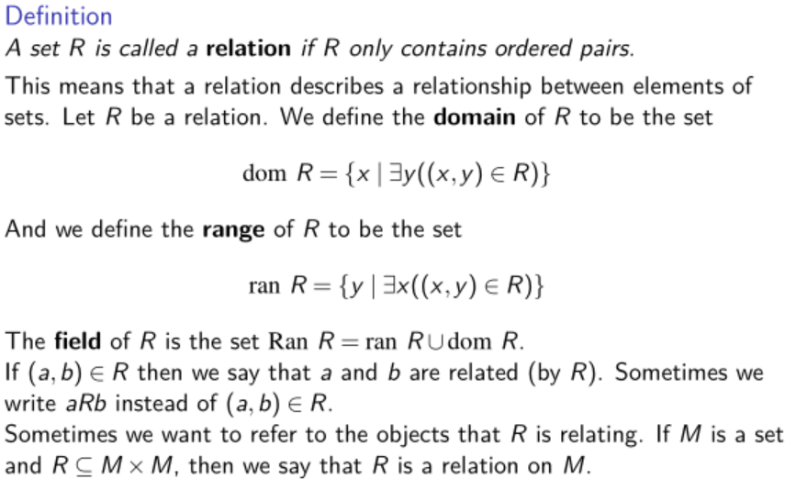
Relations

Slide 33
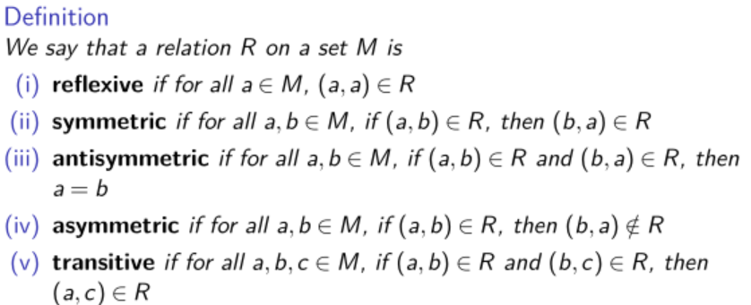
Attributes of Relations
Note the difference between antisymmetric and asymmetric!
In fact, asymmetric relations must be antisymmetric.

Slide 34
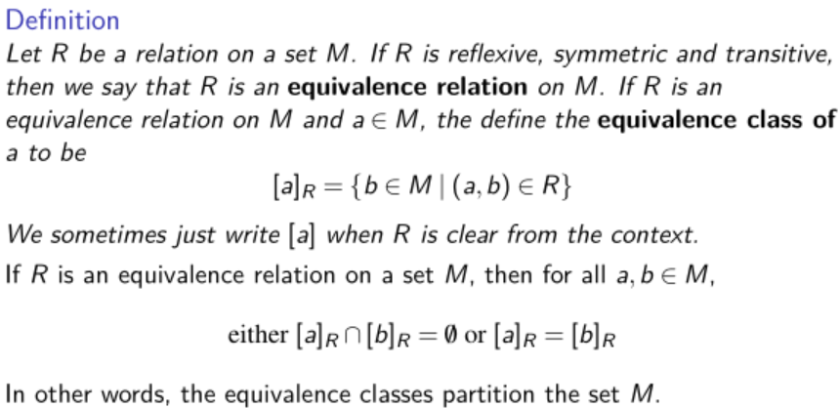
Equivalence Relations

Slide 35
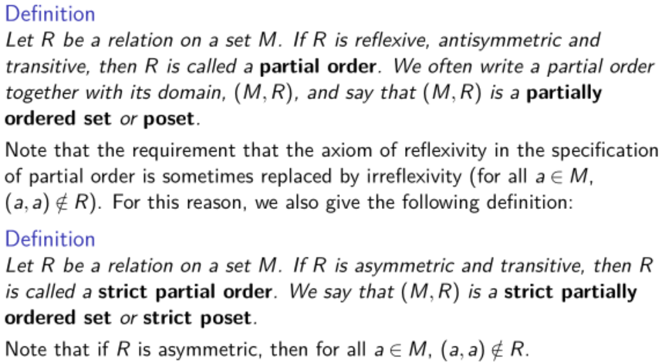
Orders

Slide 36
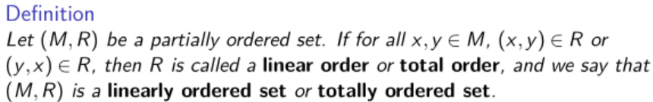
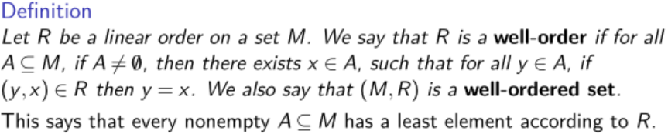
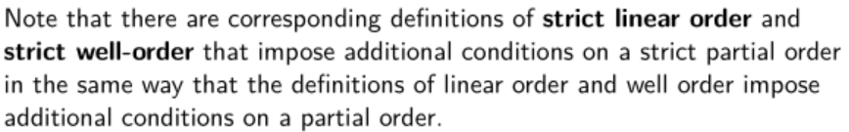
Orders

Slide 37
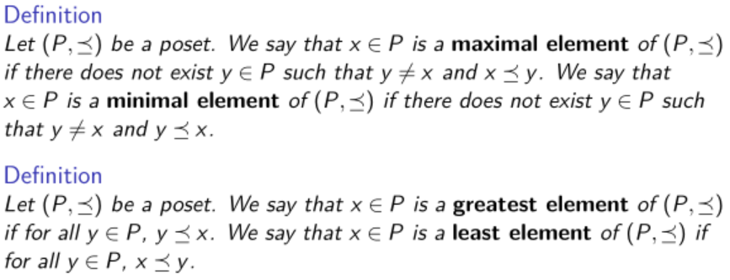
Orders
Pay attention to their differences!

Slide 38
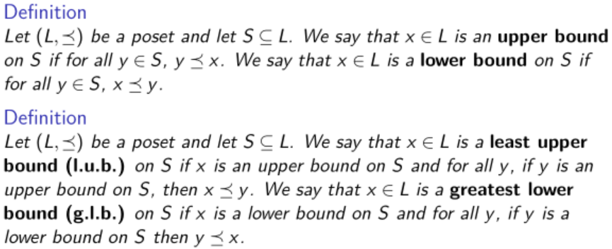
Upper and Lower Bounds

Slide 39
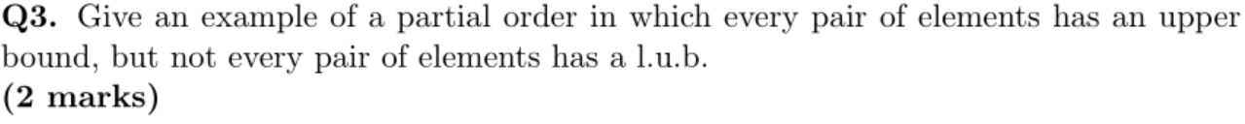
Assignment 2, Question 3
Don't just draw a Hasse Diagram without arrows!

Slide 40
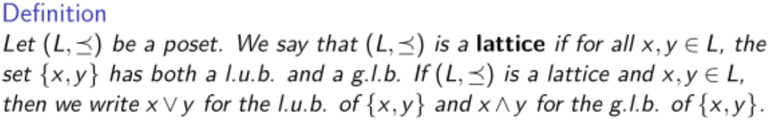
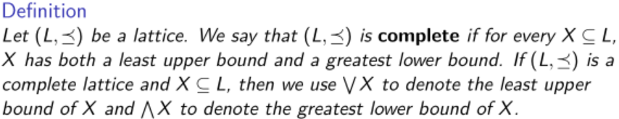
Lattice
Remark: Every non-empty finite lattice is a complete lattice.

Slide 41
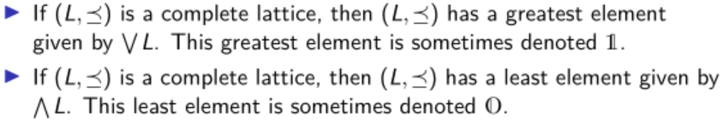
Lattice

Slide 42
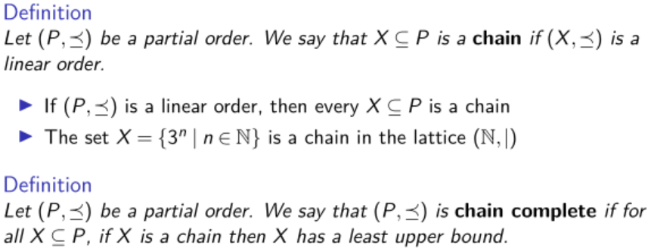
Chain Complete Posets
Always Consider the case of empty chain!
Remark: Chain complete posets have unique least elements.

Slide 43
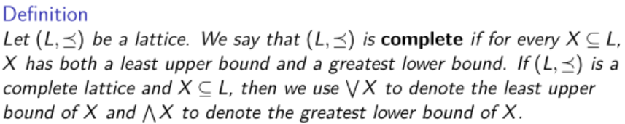
Complete Lattice Revisited

Slide 44
Relation, Order, Lattice-Summary
The definition of order, linear order, well-order
The definition of upper/lower bounds, lattice, complete lattice
The definition of chain and chain-complete poset

Slide 45
A clearer view
partial order
Equivalence Relation
lattice
unique
minimal
/maximal
element?
NOT necessarily
infinite?
NOT
necessarily
linear order = chain
well-order

Slide 46
A clearer view
partial order
lattice
complete lattice
unique
minimal
/maximal
element?
YES
infinite?
NOT
exist
complete lattice
chain-complete poset
chain-complete poset
(Unique) minimal/maximal element?
Minimal: YES; Maximal: YES, but not necessarily unique

Slide 47
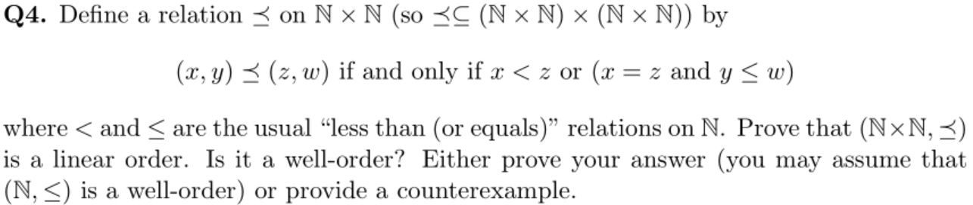
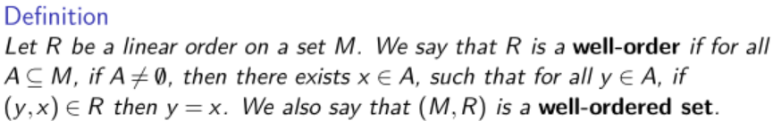
Assignment 2, Question 4

